Slide 1
Variation of Backpropagation in Neural Networks
By Kulvir Singh Saggu
(GU-2021-4246)

Slide 2
AGENDA
What is Backpropagation?
What is Backpropagation in a Neural Network?
How does Backpropagation works?
Benefits of Backpropagation
Applications of Backpropagation

Slide 3
Let me ask you a question?
Which among of the following is not a layer of a neural network?
A. Input Layer
B. Output Layer
C. Propagation Layer
D. Hidden Layer

Slide 4
What is Backpropagation?
Backpropagation is an algorithm which is created to test errors which will travel back from input nodes to output nodes.
Backpropagation is a training algorithm used for training feedforward neural networks. It plays an important part in improving the predictions made by neural networks. This is because backpropagation is able to improve the output of the neural network iteratively.
In a feedforward neural network, the input moves forward from the input layer to the output layer. Backpropagation helps improve the neural network’s output. It does this by propagating the error backward from the output layer to the input layer.
Backpropagation is applied to improve accuracy in Data Mining and Machine Learning.

Slide 5
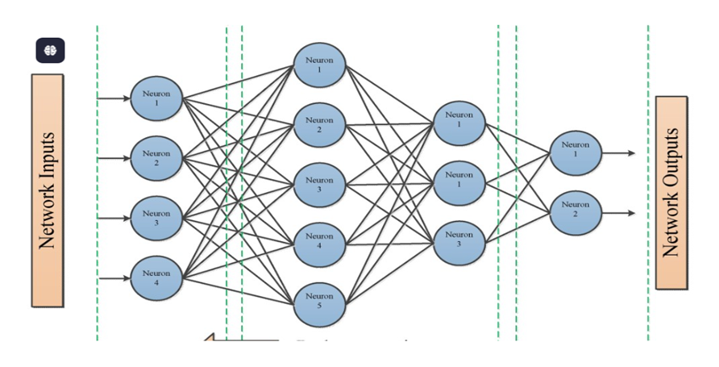
What is Backpropagation in a Neural Network?
It is similar to a biological network that contains neuron coupled with each other.
Backpropagation is used in neural networks to train the network by adjusting weights and biases based on the error (difference between predicted and actual outputs), enabling the network to learn and make better predictions

Slide 6
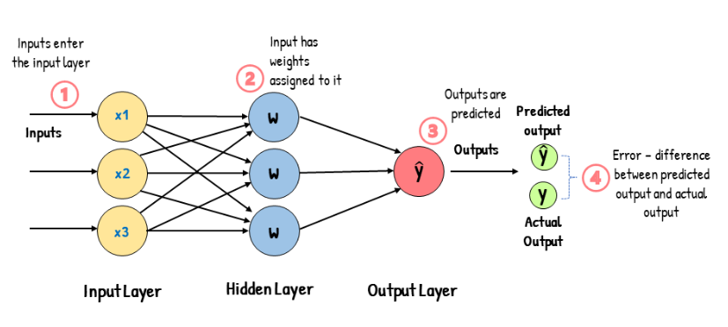
How does Backpropagation works?
It consists of an input layer, one or more hidden layers, and an output layer. The input layer receives the input into the neural network, and each input has a weight attached to it.
If the weights are randomly assigned, the neural network will likely make the wrong predictions. It will give out the incorrect output.

Slide 7
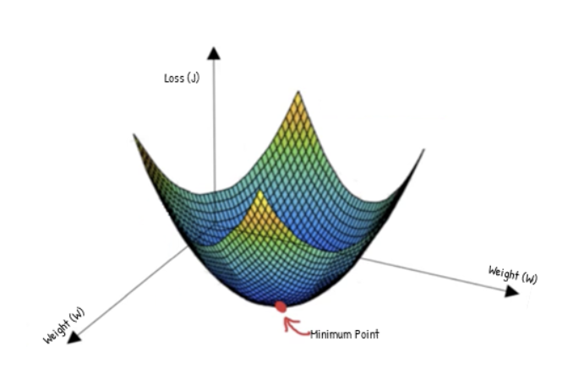
How does Backpropagation works?
When the neural network gives out the incorrect output, this leads to an output error. This error is the difference between the actual and predicted outputs. A cost function measures this error. The cost function (J) indicates how accurately the model performs. It tells us how far-off our predicted output values are from our actual values. It is also known as the error. Because the cost function quantifies the error, we aim to minimize the cost function.

Slide 8
Variations in Backpropagation
A fully connected neural network with i inputs, h hidden nodes, and o outputs has (i * h) + h + (h * o) + o weights and biases. For example, a neural network with 5 inputs, 6 hidden nodes, and 3 outputs has (5 * 6) + 6 + (6 * 3) + 3 = 57 weights and biases.
Note: Gradient descent is an optimization algorithm for finding out the local minima of a differentiable function, it helps us to find the best parameters(Weights and Biases) for the algorithm we are using for our model.

Slide 9
What is stochastic, Batch and mini Batch algorithm?
Batch Gradient Descent: It is a technique where all the data is taken into consideration while making a single update to the parameters of our model.
Stochastic Gradient Descent: It is a technique where one row or one input is taken at a time to make a single update to the parameters of our model.
Mini Batch Gradient Descent: It is a technique where a batch is taken in consideration at a time to make a single update to the parameters of our model, we can set the batch size according to us , we set the batch size and (no. of batches = Total Rows in data/batch size), it is a mid way between Batch gradient descent and Stochastic gradient descent.

Slide 10
Benefits of Backpropagation
It's essential for training deep neural networks, which are capable of learning complex, non-linear relationships in data.
Backpropagation can be applied to various tasks, including classification, regression, and pattern recognition, making it a versatile tool for different machine learning problems.
It automates the learning process, allowing the model to adjust its weights to minimize errors and improve performance over time.
Backpropagation is memory-efficient in computing derivatives, consuming less memory compared to other optimization method.

Slide 11
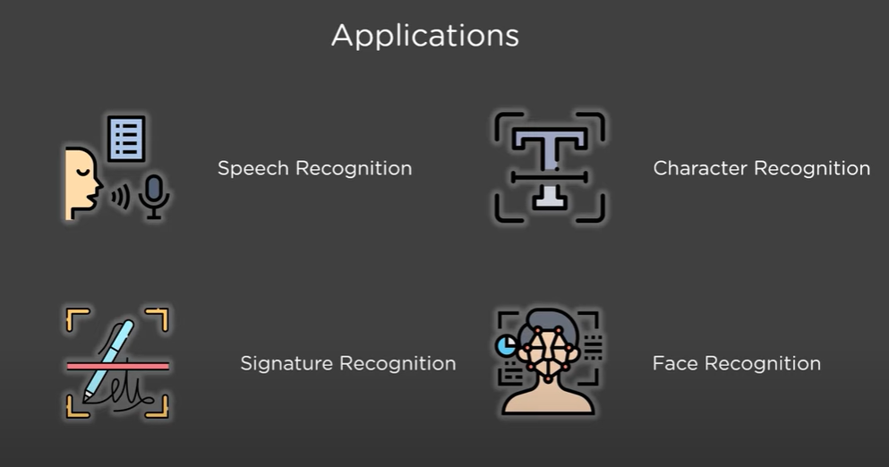
Applications of Backpropagation
Image Recognition: Backpropagation trains neural networks to recognize objects, faces, and other visual patterns in images.
Object Detection: It enables the detection and localization of objects within images, crucial for applications like autonomous vehicles.
Face Recognition: It enables the detection and localization of objects within images, crucial for applications like autonomous vehicle.
Automatic Speech Recognition (ASR): Backpropagation is used to train neural networks to convert spoken words into text.

